Slide 1
CSCI2100E Arrays & Structures

Slide 2
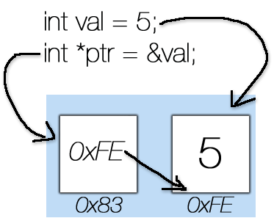
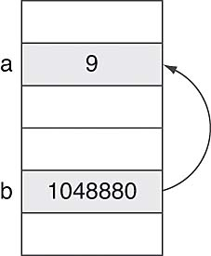
Variables and Pointers (1)
A variable is to declare a space (box) to hold a value.
int val, a;
A pointer is to declare an address of a space.
int *ptr, *b;
When using a variable/pointer,
A variable keeps a value.
A pointer keeps a value which is the address.

Slide 3
Variables and Pointers (2)
Why do we need variables and pointers?
We want to access values easily.
We want to have flexibility to access values.
Flexibility? Consider the following.
x = val + a;
y = *ptr + *b;
Are x and y the same?
#include <stdio.h>
int main()
{ int val, a, x, y;
int *ptr, *b;
val = 5; a = 9;
ptr = &val; b = &a;
x = val + a;
y = *ptr + *b;
return 0;
}

Slide 4
Variables and Pointers (3)
Two symbols: * and &.
Given a variable, say a, &a means the address of the variable.
&variable → the address of that variable
Given a pointer, say b, *b means the value kept in the address.
*address → the content kept in that address.
#include <stdio.h>
int main()
{ int val, a, x, y;
int *ptr, *b;
val = 5; a = 9;
ptr = &val; b = &a;
x = val + a;
y = *ptr + *b;
return 0;
}

Slide 5
Variables and Pointers (4)
Two symbols: * and &.
More on flexibility: to access the same content?
Example 1:
a = 9;
x = a; a = a + 1;
What is the value in x?
Example 2:
a = 9;
b = &a; a = a + 1; // What is the effect on *b?
*b = 15; // What is the value kept in a?
#include <stdio.h>
int main()
{ int val, a, x, y;
int *ptr, *b;
val = 5; a = 9;
ptr = &val; b = &a;
x = val + a;
y = *ptr + *b;
return 0;
}

Slide 6
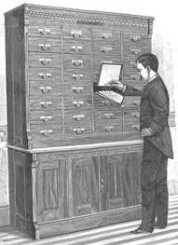
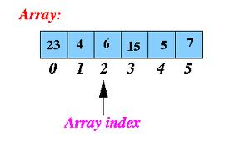

Array
An array is used to group the same objects together.
Good things: If you know the index (where), you can find the object (content) in one step.
Bad things: If you want to insert an object in a place between two objects in an array, you have to move the objects first.
Array as an ADT
Array plus operations associate with it.

Slide 7
Overview of Arrays in C
int list[8], *ptr[8];
Let the size of the array be n. The first element and the last element are indexed by 0 and n-1, respectively.
Let the base address of an array to be a. The address of the i-th element is located at a+(i-1) x sizeof(theTypeOfElement).
Example of Usages: ptr[0] = &list[0]; ptr[1] = &list[2]; list[3] = list[2]; ptr[0] = list; ptr[1] = list + 2; list[3] = *ptr[1];

Slide 8
Arrays in C
Create an array statically (when you write the program, and when you know how many elements you need to access).
int list[8];
list[0] = 10;
Create an array dynamically (when you run the program, and when you don’t know how many elements you need to access).
int *list;
list = (int*)malloc(8 * sizeof(int));
list[0] = 10;
Create and initialize an array (when you write the program).
int list[] = {10, 20, 30, 40, 50, 60, 70, 80};
What is the ‘number of elements’?
int size;
size = sizeof(list) /sizeof(int);

Slide 9
Pointers and Arrays
int *iptr; // to declare a pointer to int
char *cptr; // to declare a pointer to char
A pointer has a type. It can point to an int, or a char, …..
In general, a pointer can point to a sequence of ints, or chars, ….
int n = 8;
iptr = (int*)malloc(n * sizeof(int));
Malloc (memory allocation) is to allocate a piece of memory. As a procedure, malloc returns a type (char*).
(int*) is used to match the type at both side.

Slide 10
Pointers and Arrays
Let the base address of an array to be a. The address of the i-th element of an array is located at a+(i-1)x sizeof(theTypeOfElement).
So, a pointer pointing a memory can be considered as an array.
iptr[2] = 10;
About the “+” for address.
Iptr + 2 → move two integers away from the base address
Cptr + 2 → move two chars away from the base address

Slide 11
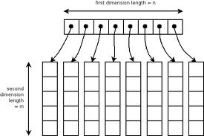
Multi-Dimensional Arrays in C
C uses the so-called array-of-arrays representation to represent a multidimensional array.
A two-dimensional array int x[8][5]

Slide 12
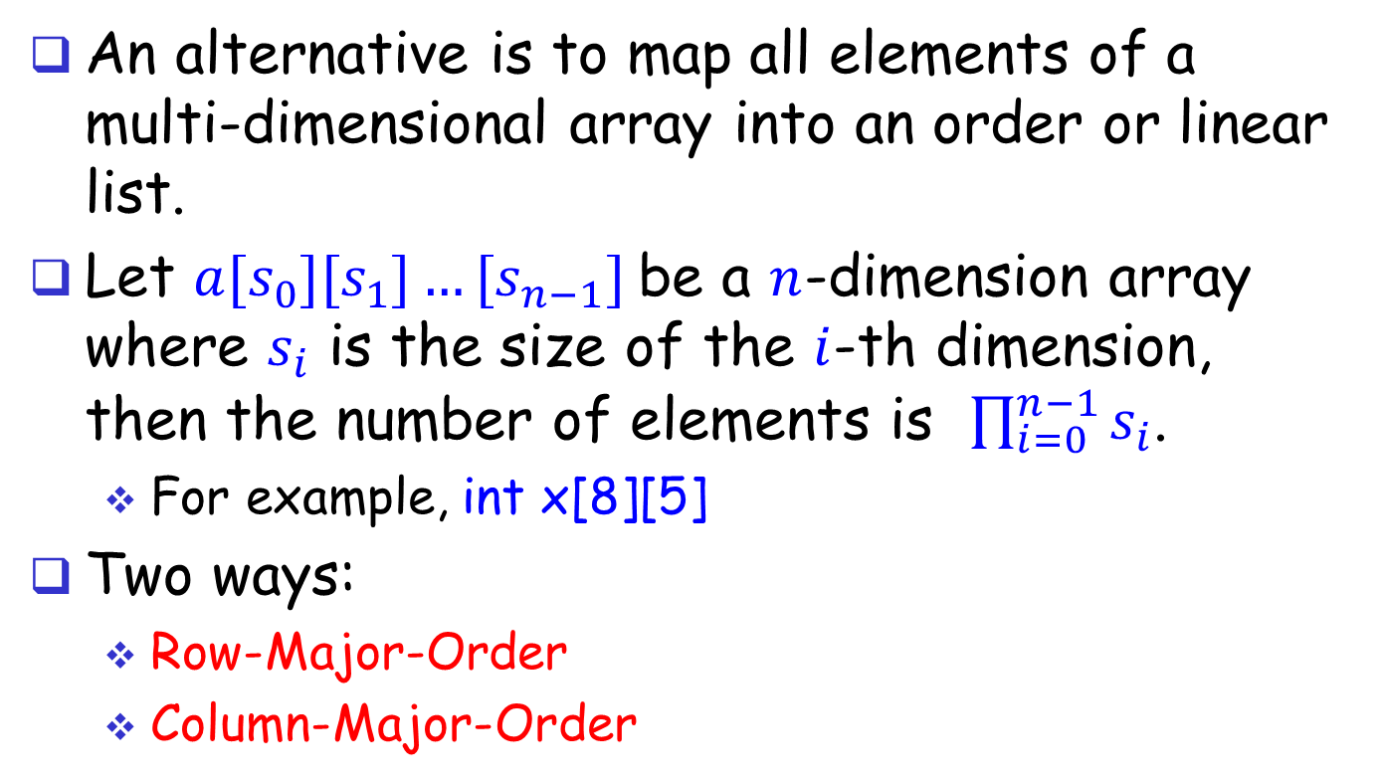
Multi-Dimensional Arrays
An alternative is to map all elements of a multi-dimensional array into an order or linear list.
Let $a[s_{0}][s_{1}]…[s_{n−1}]$be a $n$-dimension array where $s_{i}$ is the size of the $i$-th dimension, then the number of elements is $\prod_{i=0}^{n−1}{s_{i}}$.
For example, int x[8][5]
Two ways:
Row-Major-Order
Column-Major-Order

Slide 13
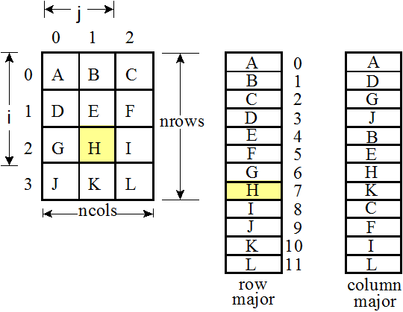
Row Major Order vs Column Major Order

Slide 14
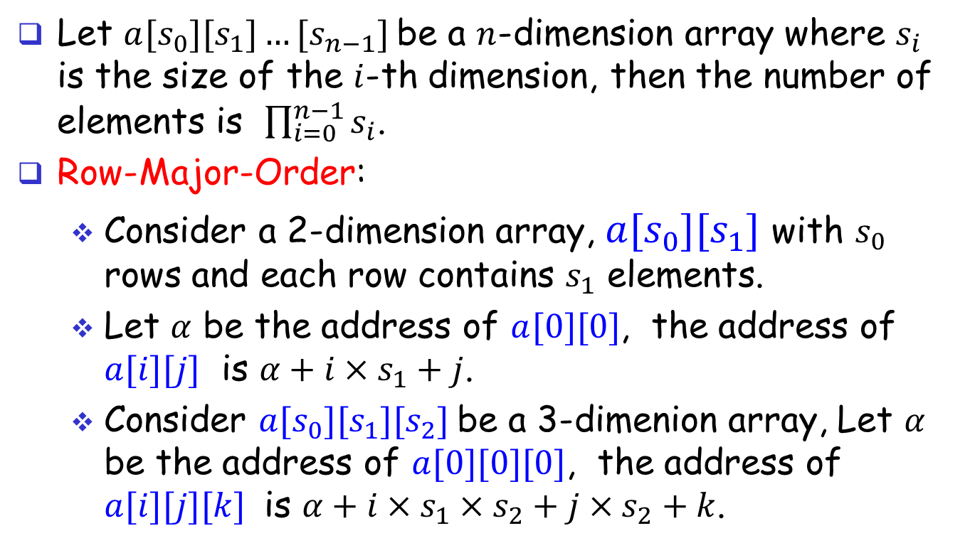
Multi-Dimensional Arrays
Let $a[s_{0}][s_{1}]…[s_{n−1}]$be a $n$-dimension array where $s_{i}$ is the size of the $i$-th dimension, then the number of elements is $\prod_{i=0}^{n−1}{s_{i}}$.
Row-Major-Order:
Consider a 2-dimension array, $a[s_{0}][s_{1}]$ with $s_{0}$ rows and each row contains $s_{1}$ elements.
Let $α$ be the address of $a[0][0]$, the address of $a[i][j]$ is $α+i×s_{1}+j$.
Consider $a[s_{0}][s_{1}][s_{2}]$be a 3-dimenion array, Let $α$ be the address of $a[0][0][0]$, the address of $a[i][j][k]$ is $α+i×s_{1}×s_{2}+j×s_{2}+k$.

Slide 15
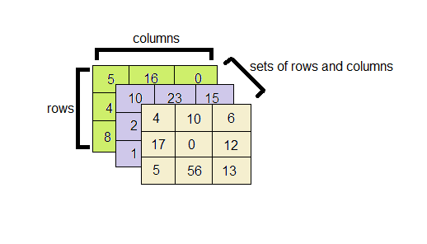
A 3-dimension Array Example A[3][3][3]
A[0][0][1]
A[1][0][2]
A[2][1][2]
The address of A[0][0][1] is a+0*3*3+0*3+1=a+1
The address of A[1][0][2] is a+1*3*3+0*3+2=a+11
The address of A[2][1][2] is a+2*3*3+1*3+2=a+23

Slide 16
Overview of Structures in C
Grouping data of different/same types.
Declare as user-defined data types:
typedef struct { typedef struct { typedef struct {
int day; char name[16]; char name[16];
int month; int student_id; int student_id;
int year; float mark; float mark;
} date; char grade; char grade;
date dob; date *dob;
} student; } studentp;
Some usages: (Note, there are “.” and “->”)
student s1, s2;
studentp p1, p2;
date dob;
s1.dob.year = 1979;
strcpy(s1.name, "Mr.Right");
p1.dob = &dob;
p2.dob = &dob;
p1.dob->year = 1979;
Both “.” and “->” are to access a data field defined in a data structure.
“.” is to access a data field in a variable.
“->” is to access a data field in a pointer.

Slide 17
Self-Referential Structures
#define NULL 0
typedef struct _list {
int i;
struct _list *link;
} list;
int main()
{
list item1, item2, item3, *itemVar;
item1.i = 10; item2.i = 20; item3.i = 30;
item1.link = &item2; item2.link = &item3;
item3.link = NULL; itemVar = &item1;
while (itemVar != NULL) {
printf("%d\n", itemVar->i);
itemVar = itemVar->link;
}
return 0;
}

Slide 18
Array as an ADT
An array is a collection of data of the same type.
An array is a set of pairs, (index, value), where each index that is defined has a value associated with it.
Other than array creation, 2 standard array operations are:
retrieve a value
store a value

Slide 19
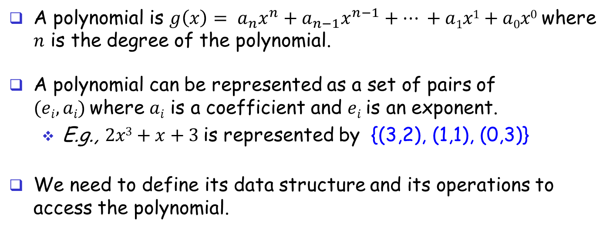
The Polynomial ADT
A polynomial is $g\left(x\right)= a_{n}x^{n}+a_{n−1}x^{n−1}+… +a1x1+a0x0$where $n$ is the degree of the polynomial.
A polynomial can be represented as a set of pairs of $(ei, ai)$where $ai$ is a coefficient and $ei$is an exponent.
E.g., $2x3+x+3$is represented by {(3,2), (1,1), (0,3)}
We need to define its data structure and its operations to access the polynomial.

Slide 20
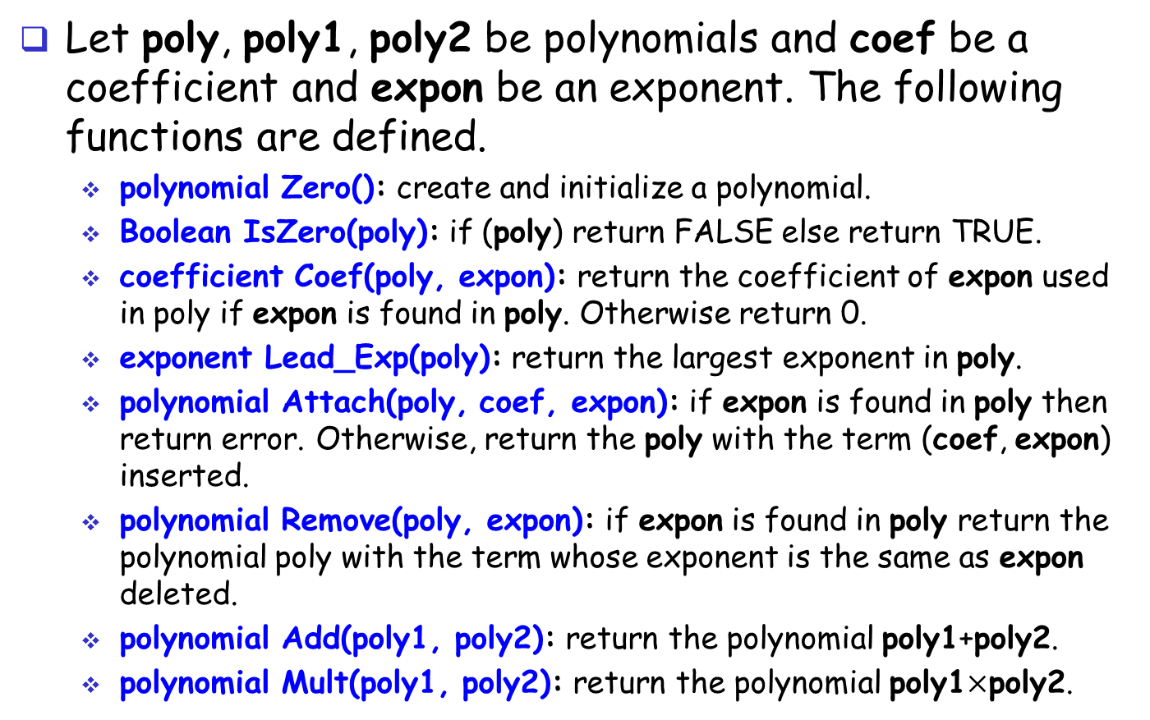
The Polynomial ADT
Let poly, poly1, poly2 be polynomials and coef be a coefficient and expon be an exponent. The following functions are defined.
polynomial Zero(): create and initialize a polynomial.
Boolean IsZero(poly): if (poly) return FALSE else return TRUE.
coefficient Coef(poly, expon): return the coefficient of expon used in poly if expon is found in poly. Otherwise return 0.
exponent Lead_Exp(poly): return the largest exponent in poly.
polynomial Attach(poly, coef, expon): if expon is found in poly then return error. Otherwise, return the poly with the term (coef, expon) inserted.
polynomial Remove(poly, expon): if expon is found in poly return the polynomial poly with the term whose exponent is the same as expon deleted.
polynomial Add(poly1, poly2): return the polynomial poly1+poly2.
polynomial Mult(poly1, poly2): return the polynomial poly1$×$poly2.

Slide 21
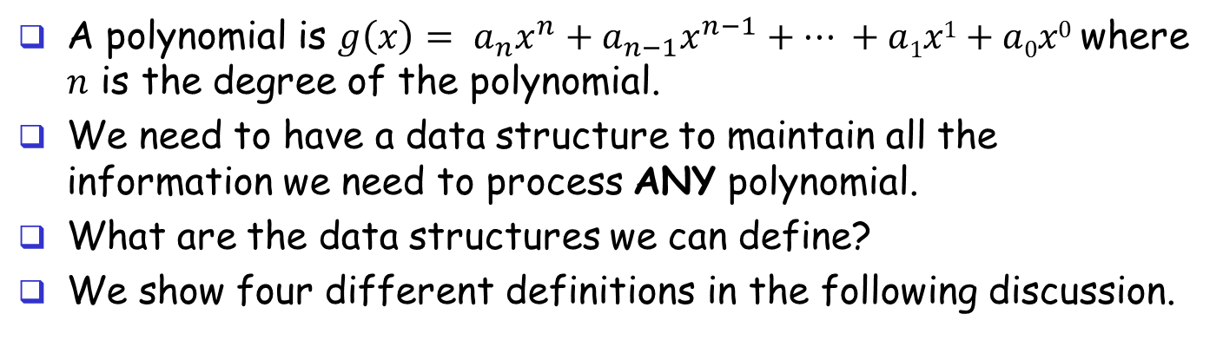
Data Structures for Polynomial ADT
A polynomial is $g\left(x\right)= a_{n}x^{n}+a_{n−1}x^{n−1}+… +a1x1+a0x0$where $n$ is the degree of the polynomial.
We need to have a data structure to maintain all the information we need to process ANY polynomial.
What are the data structures we can define?
We show four different definitions in the following discussion.

Slide 22
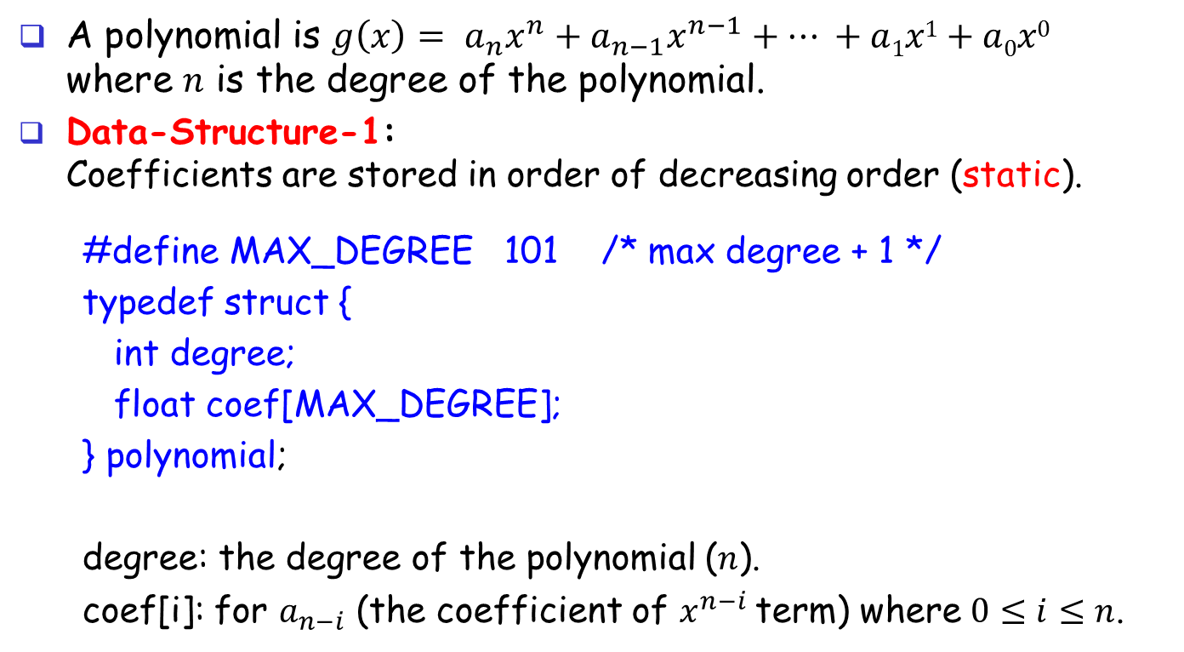
Data Structures for Polynomial ADT (cont’d)
A polynomial is $g\left(x\right)= a_{n}x^{n}+a_{n−1}x^{n−1}+… +a1x1+a0x0$ where $n$ is the degree of the polynomial.
Data-Structure-1: Coefficients are stored in order of decreasing order (static).
#define MAX_DEGREE 101 /* max degree + 1 */
typedef struct {
int degree;
float coef[MAX_DEGREE];
} polynomial;
degree: the degree of the polynomial ($n$).
coef[i]: for $a_{n−i}$ (the coefficient of $x^{n−i}$term) where $0≤i≤n$.

Slide 23

Data Structure 1 Example
$A(x)=2x100+1$
$B(x)=x4+9x3+3x2+1$
i =
0
1
2
3
98
99
100
2
0
0
0
...
0
0
1
i =
0
1
2
3
96
97
98
99
100
0
0
0
0
...
1
9
3
0
1
Disadvantage: waste memory space if $n≪$MAX_DEGREE.

Slide 24
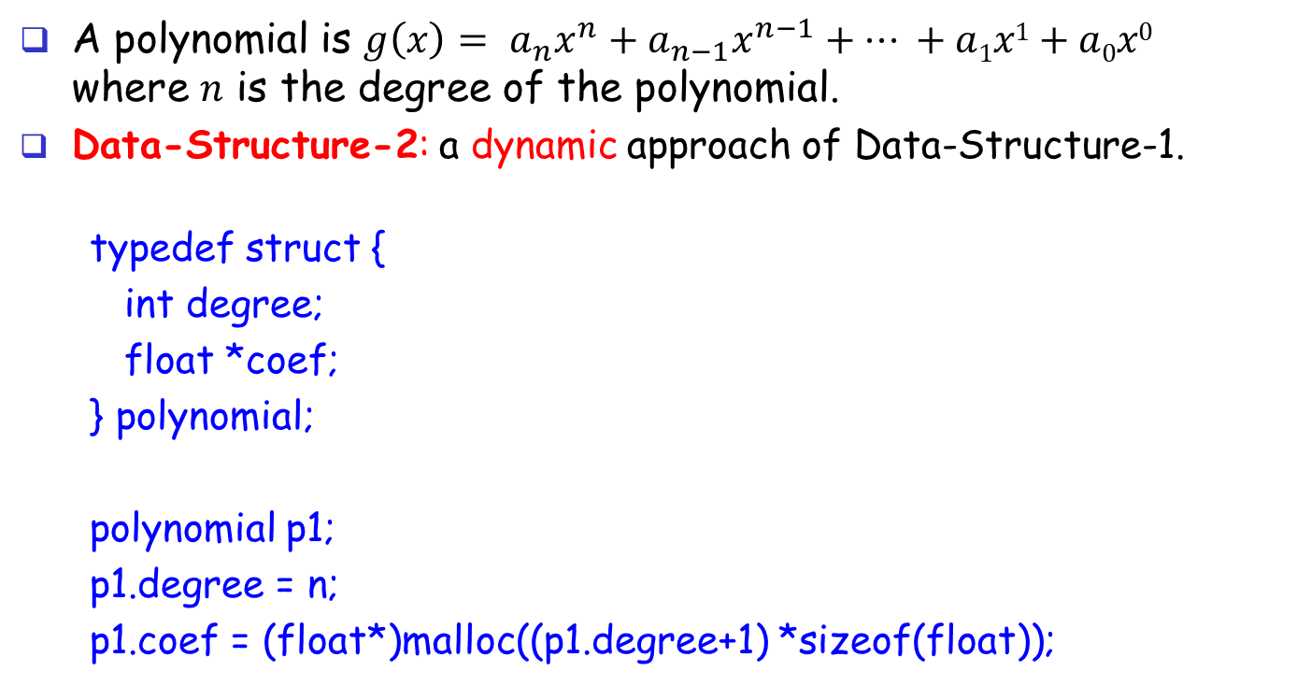
Data Structures for Polynomial ADT (cont’d)
A polynomial is $g\left(x\right)= a_{n}x^{n}+a_{n−1}x^{n−1}+… +a1x1+a0x0$ where $n$ is the degree of the polynomial.
Data-Structure-2: a dynamic approach of Data-Structure-1.
typedef struct {
int degree;
float *coef;
} polynomial;
polynomial p1;
p1.degree = n;
p1.coef = (float*)malloc((p1.degree+1) *sizeof(float));

Slide 25

Data Structure 2 Example
$A(x) = 2x100+1$
$B(x) = x4+9x3+3x2+1$
i =
0
1
2
3
98
99
100
2
0
0
0
...
0
0
1
i =
0
1
2
3
4
1
9
3
0
1

Slide 26
Data Structures for Polynomial ADT (cont’d)
Data-Structure-3: typedef struct { int expon; float coef;
} polynomialbuffer; typedef struct { int start; int finish; } polynomial;
A polynomialbuffer to keep many.
#define MAX_TERM 100
int avail = 0;
polynomialbuffer global[MAX_TERM];
polynomial a, b;

Slide 27
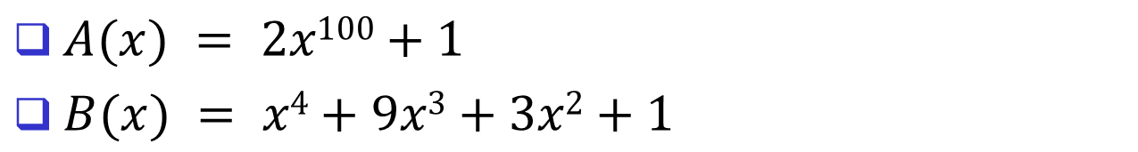
Data Structure 3 Example
$A(x) = 2x100+1$
$B(x) = x4+9x3+3x2+1$
global
0
1
2
3
4
5
6
100
0
4
3
2
0
expon
2
1
1
9
3
1
coef
a.start
b.start
b.finish
a.finish
avail

Slide 28
Data Structures for Polynomial ADT (cont’d)
Data-Structure-4: typedef struct {
int expon;
float coef;
} term;
typedef struct {
int number; /* the number of terms */
term *terms;
} polynomial;
polynomial p;
p.number = m;
p.terms = (term*)malloc(p.number * sizeof(term));

Slide 29
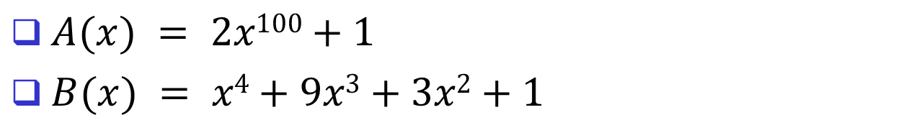
Data Structure 4 Example
$A(x) = 2x100+1$
$B(x) = x4+9x3+3x2+1$
p.number
p.terms
2
expon
100
0
coef
2
1
p.number
p.terms
4
4
3
2
0
expon
coef
1
9
3
1

Slide 30



Implementation of the Polynomial Add Function
$$a=2x4+3x2+x+2$$
$$b=9x3+2x2+2x$$
$$d=2x4+9x3+5x2+3x+2$$
#define COMPARE(x,y) (((x) < (y)) ? -1: ((x) == (y))? 0: 1)
/* d = a + b, where a, b, and d are polynomials */
d = Zero();
while (!(IsZero(a) && IsZero(b))) {
switch (COMPARE(Lead_Exp(a), Lead_Exp(b))) {
case -1: d = Attach(d,Coef(b, Lead_Exp(b)), Lead_Exp(b));
b = Remove(b, Lead_Exp(b));
break;
case 0: sum = Coef(a, Lead_Exp(a)) + Coef(b, Lead_Exp(b));
if (sum != 0) Attach(d, sum, Lead_Exp(a));
a = Remove(a, Lead_Exp(a));
b = Remove(b, Lead_Exp(b));
break;
case 1: d = Attach(d, Coef(a, Lead_Exp(a)), Lead_Exp(a));
a = Remove(a, Lead_Exp(a));
}}

Slide 31



Polynomial Add: Example
$$a=2x4+3x2+x+2$$
a.number
a.terms
4
4
2
1
0
expon
coef
2
3
1
2
$$b=9x3+2x2+2x$$
b.number
b.terms
3
3
2
1
expon
coef
9
2
2
$$d=2x4+9x3+5x2+3x+2$$
d.number
d.terms
5
4
3
2
1
0
expon
coef
2
9
5
3
2

